Slide 1

ёPRSTCON · DEPARTURES
26.05.2026 · MOW
— SLIDE 01 —
The Dark Side of the Chinese Internet
A deep dive into one of the most closed and peculiar parts of the internet
MIKHAIL ALEKSEENKO · Analyst (OSINT + Dark Web)
PT Cyber Analytics · 26.05.2026
▶

Slide 2
ёPRSTCON · The Dark Side of the Chinese Internet
26.05.2026 · MOW
— SLIDE 02 —
Table of contents
01 · Why China at All?
02 · History of the Chinese Dark Web
03 · Chinese Dark Web Forums & Markets
04 · Chinese Hackers & Hacker Groups
05 · Comparison of Chinese and European/CIS Dark Web Forums
▶

Slide 3
ёPRSTCON · The Dark Side of the Chinese Internet
26.05.2026 · MOW
— SLIDE 03 —
01
Why China at All?
▶

Slide 4
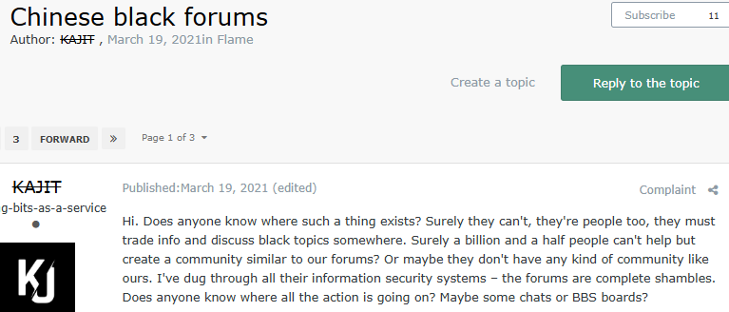
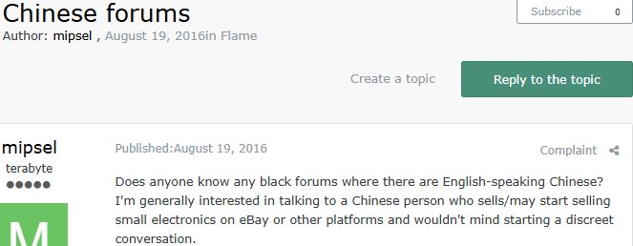

ёPRSTCON · The Dark Side of the Chinese Internet
26.05.2026 · MOW
— SLIDE 04 —
The topic has been relevant for more than 10 years
2021
2016
2025
▶

Slide 5



ёPRSTCON · The Dark Side of the Chinese Internet
26.05.2026 · MOW
— SLIDE 05 —
A closed community for «our own» only
Great firewall of China
Another society with different traditions
Many Chinese people do not know English
▶

Slide 6
ёPRSTCON · The Dark Side of the Chinese Internet
26.05.2026 · MOW
— SLIDE 06 —
02
Becoming of the Chinese Dark Web
▶

Slide 7
ёPRSTCON · The Dark Side of the Chinese Internet
26.05.2026 · MOW
— SLIDE 07—
Development of hacker forums and communities
The emergence of hacker-for-hire offers, sales of exploits, remote access tools, etc
First Chinese hacker groups
Honker Union (红客联盟)
Wicked Rose (玫瑰)
China Eagle (中国鹰)
Great Firewall of China
Launch of the Golden Shield Project
1998 | 2000 | 2003 | 2004 | 2004 2007 | 2005
First Chinese hacking forums
The most popular was the hacker forum of the Honker Union group
Collapse/Disappearance of the first groups and forums
The first groups ceased their activities and closed their forums
Start of active arrests of hackers
Chinese cyber police infiltrated the hacker group Shadow (阴影) via forums and chats
▶

Slide 8
ёPRSTCON · The Dark Side of the Chinese Internet
26.05.2026 · MOW
85% of dark forums closed
Alibaba Market
UCEM
Tea Horse Road Market (茶马古道)
Loulan City Market (楼兰城)
— SLIDE 08 —
Rise of China’s dark web
Emergence of Chinese-forums and marketplaces on Tor:
Dark Web Chinese Forum
(暗网中文论坛)
Alibaba Market
UCEM (联合中文担保交 易市场)
Forum transformation
Gradual transition of illicit forums to closed, paid platforms and private chats; shift from illegal to educational content
2008 | 2011 2013 | 2013 2019 | May 2020 | 2020 2022 | 2023 2026
Silk Road
Popularization of Tor sites and payments in Bitcoin
The first Chinese dark web platform shut down by police
Jiangsu police announced the closure of a dark marketplace hosting pornographic content
IN THIS RESEARCH
▶

Slide 9
ёPRSTCON · The Dark Side of the Chinese Internet
26.05.2026 · MOW
— SLIDE 09 —
03
Chinese Dark Web Forums & Markets
▶

Slide 10
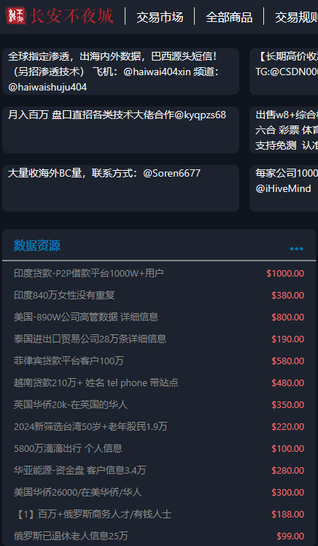
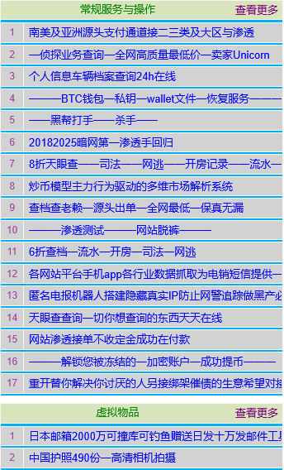
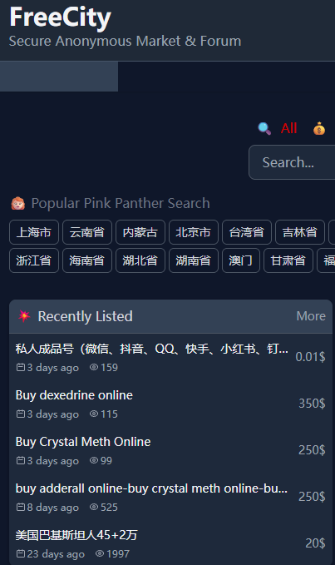
ёPRSTCON · The Dark Side of the Chinese Internet
26.05.2026 · MOW
— SLIDE 10 —
Chang'an Never Sleeps City (长安不夜城)
Free City (自由城)
Dark Web Chinese Forum (暗网中文论坛)
▶

Slide 11
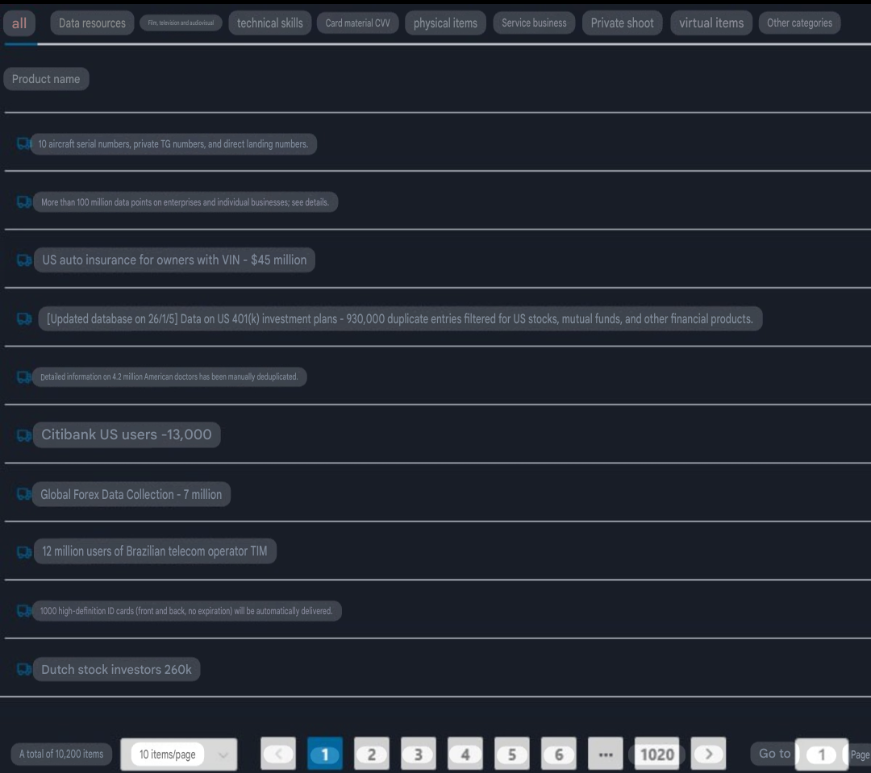





ёPRSTCON · The Dark Side of the Chinese Internet
26.05.2026 · MOW
— SLIDE 11 —
1 Cryptocurrency
2 Data leaks
3 Malware & Exploits
Markets trends
Сountries with the most data leaks are:
1.
2.
3.
4.
5.
▶

Slide 12
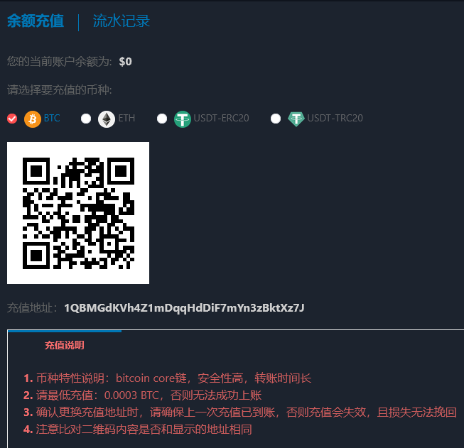

ёPRSTCON · The Dark Side of the Chinese Internet
26.05.2026 · MOW
— SLIDE 12 —
Business model
All 3 marketplaces operate under the same business model:
Deposit in BTC/ETH/USDT
Withdrawal in BTC/ETH/USDT with a 0,2-3% commission
Purchases are made through the automated internal system
▶

Slide 13
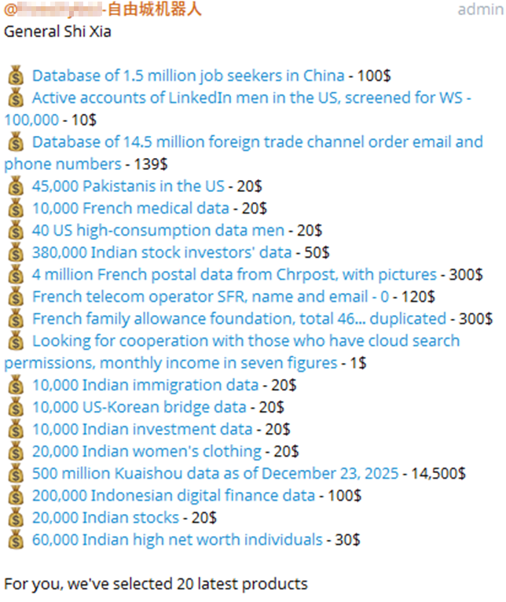
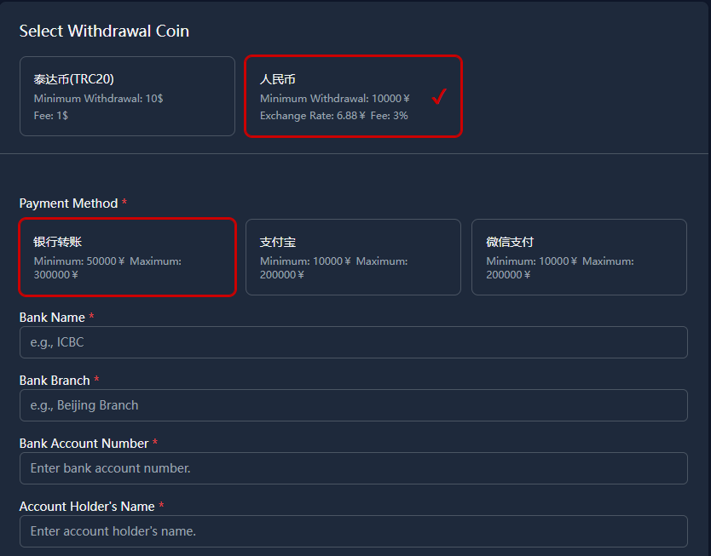
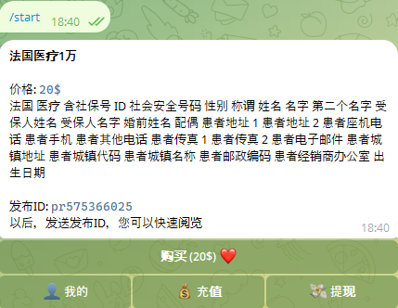
ёPRSTCON · The Dark Side of the Chinese Internet
26.05.2026 · MOW
— SLIDE 13 —
At the same time, Freecity has a more developed business model
Purchases via Telegram bot
Withdrawals are also possible via bank card/Alipay/WeChat
▶

Slide 14
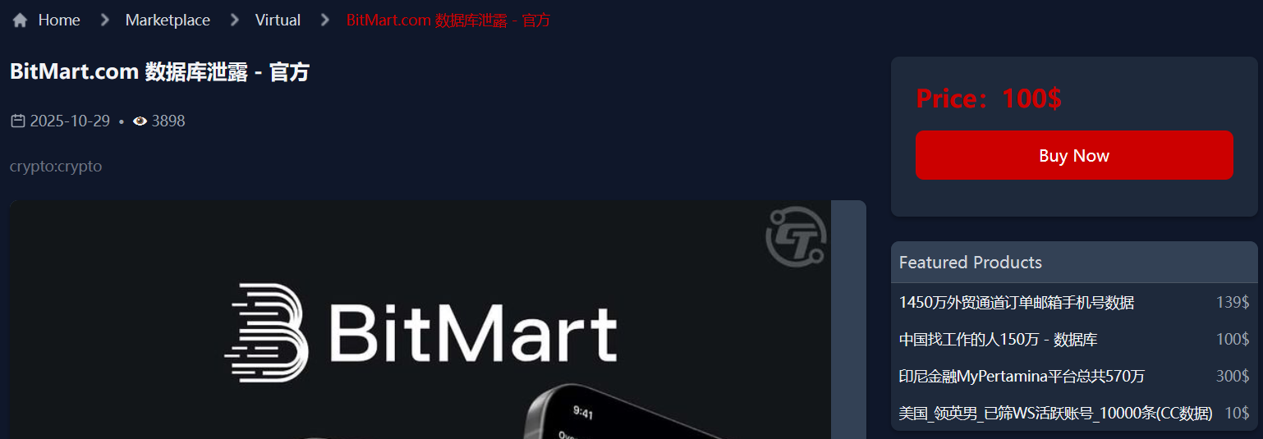
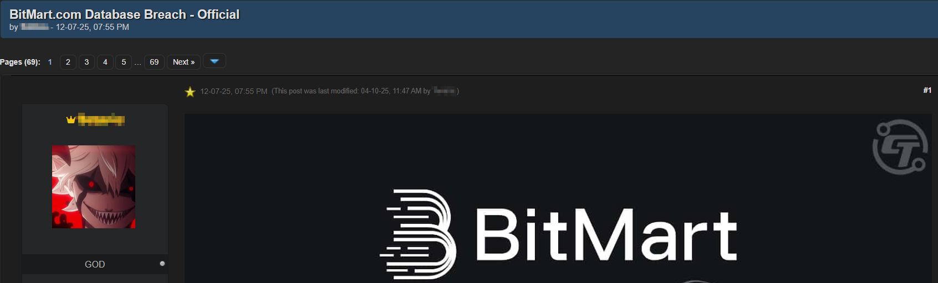
ёPRSTCON · The Dark Side of the Chinese Internet
26.05.2026 · MOW
— SLIDE 14 —
Pricing policy
Average price for a private databases with more than 500 000 rows:
On the Chinese markets: 410$
On the European/CIS forums: 808$
Lots of public database sales
▶

Slide 15

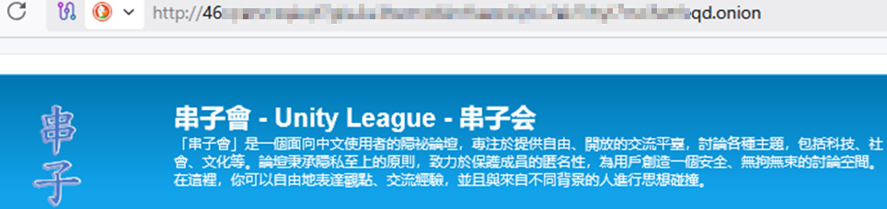
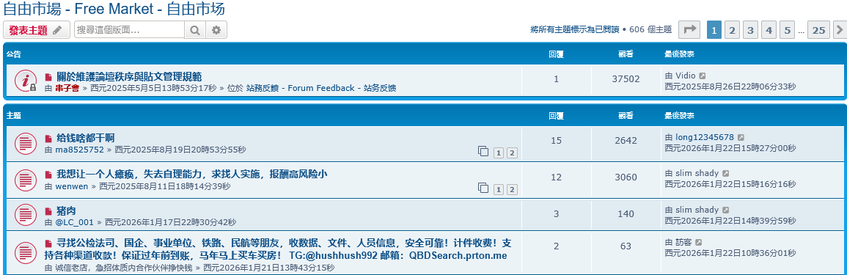
ёPRSTCON · The Dark Side of the Chinese Internet
26.05.2026 · MOW
— SLIDE 15 —
Other Dark Web platforms
Hacker for Hire Platform
A forum for discussing any illegal topics
For example: «How to get away with murder in China»
▶

Slide 16
ёPRSTCON · The Dark Side of the Chinese Internet
26.05.2026 · MOW
— SLIDE 16 —
04
Chinese Hackers & Hacker Groups
▶

Slide 17
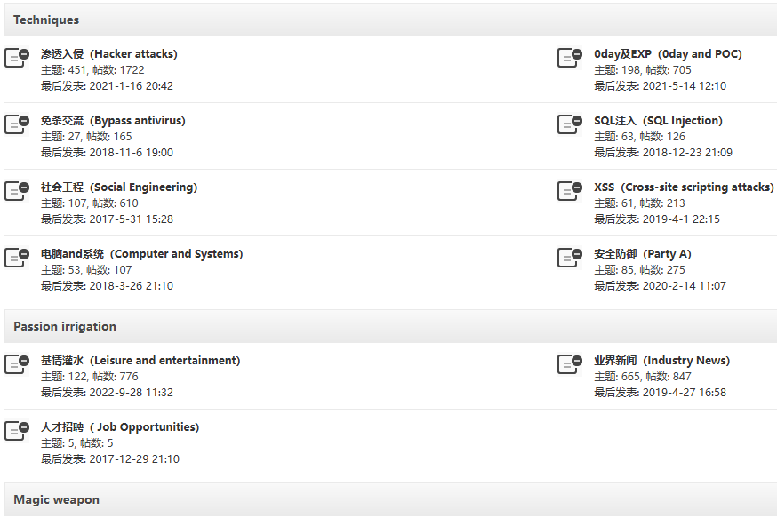
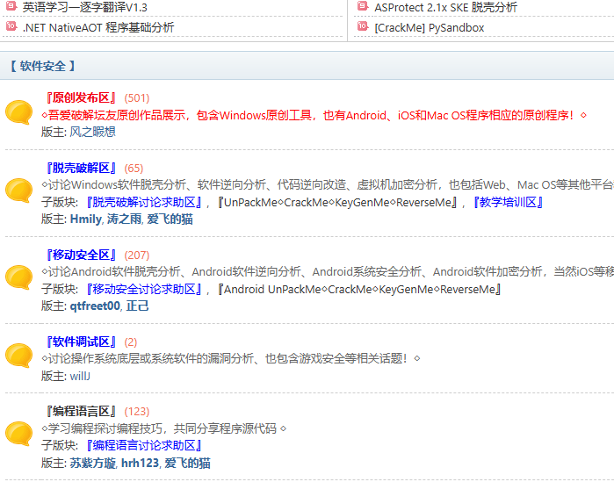
ёPRSTCON · The Dark Side of the Chinese Internet
26.05.2026 · MOW
— SLIDE 17 —
A highly developed hacking training system
Old-style Chinese forum
Modern Chinese forum
There are more than 40 active clearnet forums dedicated to hacking education
▶

Slide 18
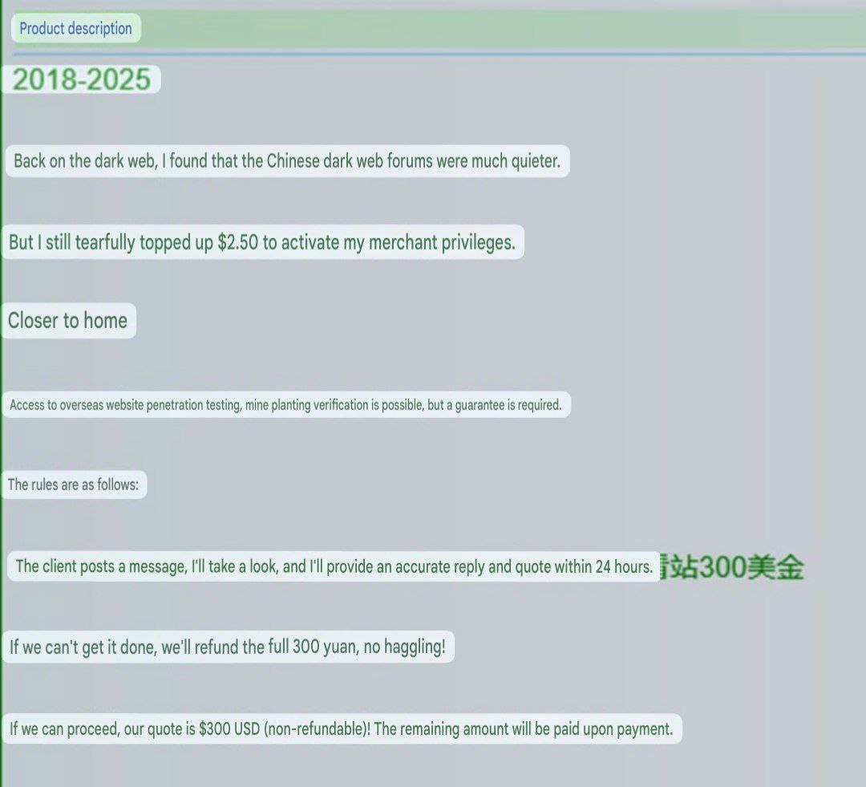
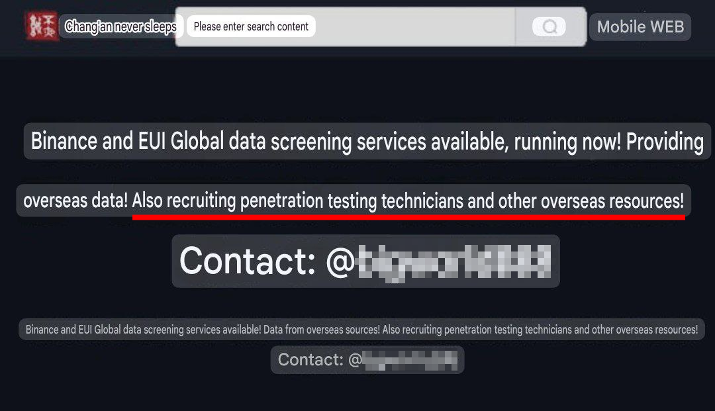
ёPRSTCON · The Dark Side of the Chinese Internet
26.05.2026 · MOW
— SLIDE 18 —
Recruitment to hacker groups
▶

Slide 19
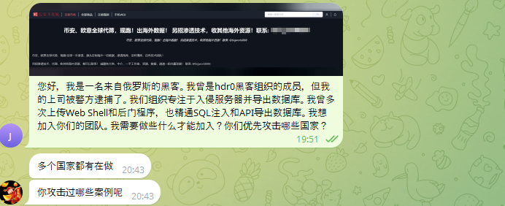
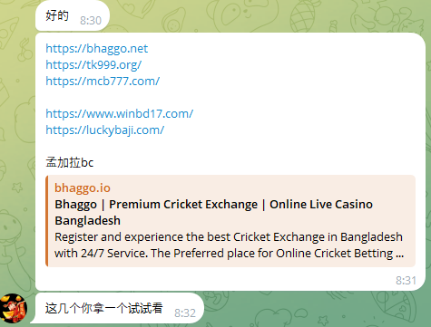
ёPRSTCON · The Dark Side of the Chinese Internet
26.05.2026 · MOW
— SLIDE 19 —
What does it take to join a Chinese hacker group?
<I'm a cool hacker from Russia, I can do everything. I want to join your group>
GOOD
Bangladesh
What have you managed to hack?
Try to hack one of these sites
▶

Slide 20
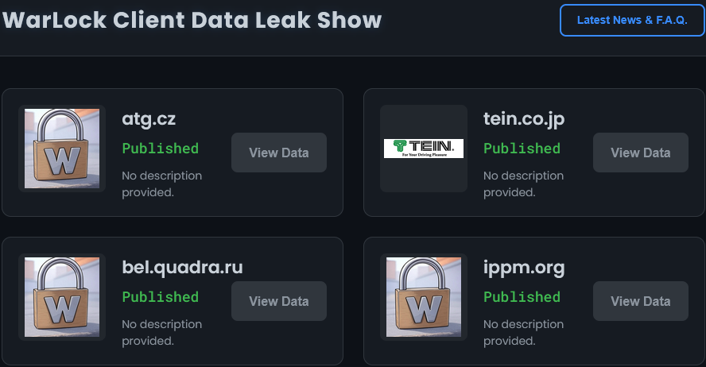
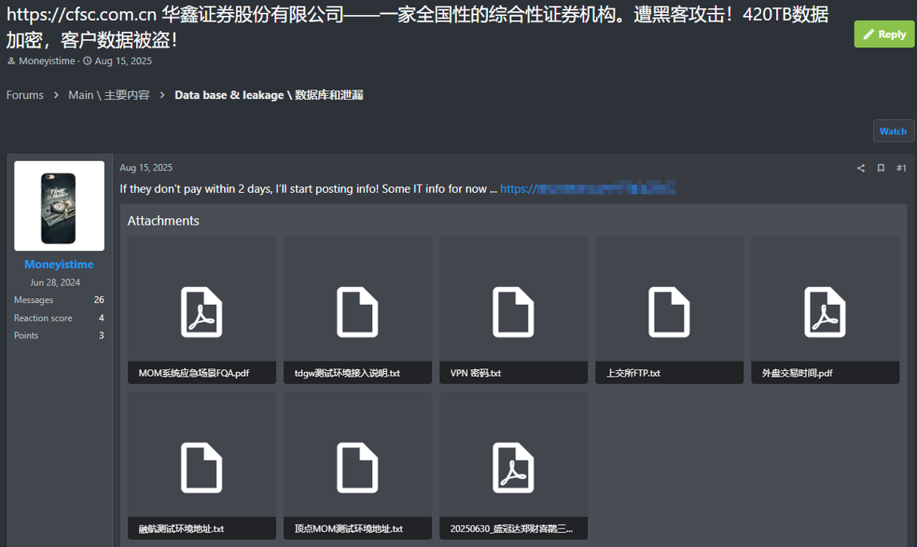
ёPRSTCON · The Dark Side of the Chinese Internet
26.05.2026 · MOW
— SLIDE 20 —
Chinese ransomware groups
China-based threat-actor Storm-2603 is using Warlock ransomware
Small ransomware groups prefer to post ads on closed European forums
▶

Slide 21
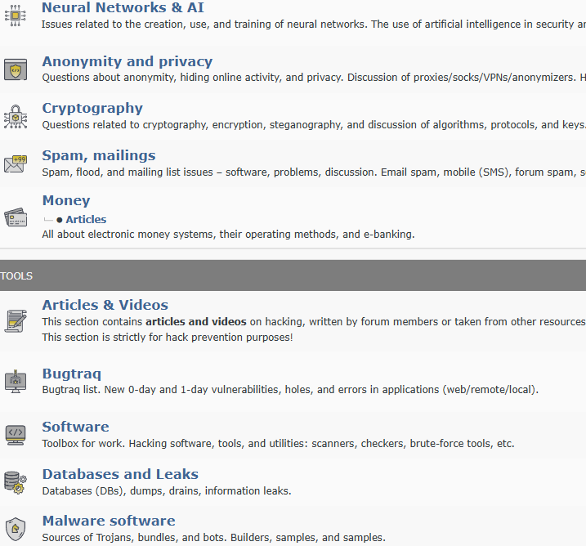
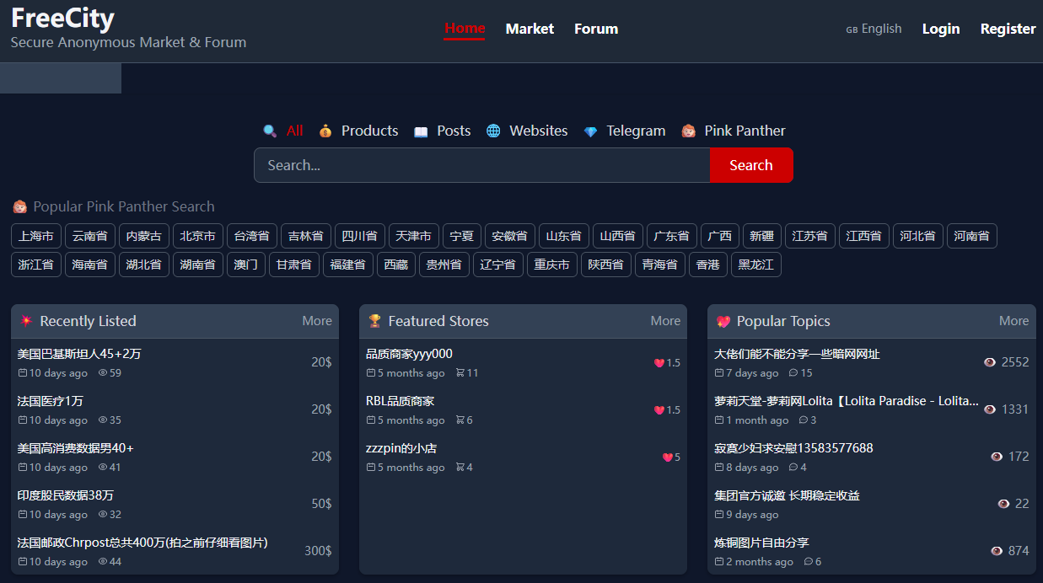
ёPRSTCON · The Dark Side of the Chinese Internet
26.05.2026 · MOW
05
— SLIDE 21 —
European/CIS Forums
Chinese Forums
≠
▶

Slide 22
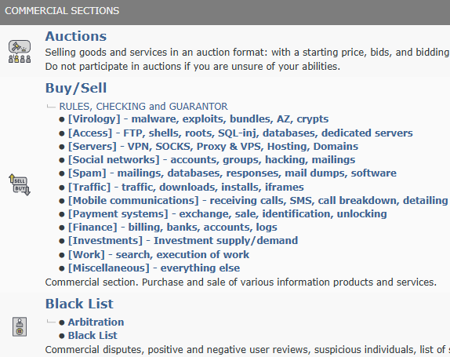
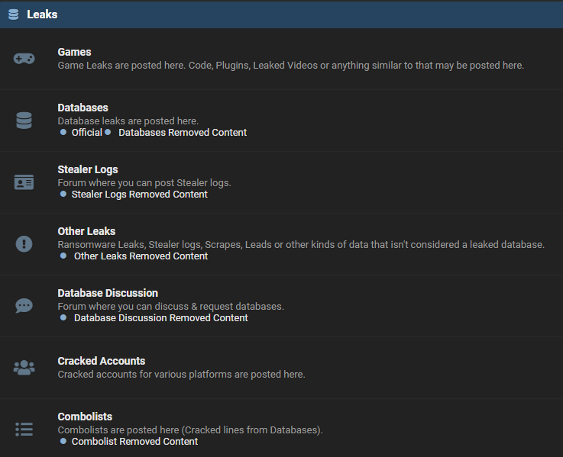
ёPRSTCON · The Dark Side of the Chinese Internet
26.05.2026 · MOW
— SLIDE 22 —
Hacker business forums are widespread in Europe and the CIS
▶

Slide 23
ёPRSTCON · The Dark Side of the Chinese Internet
26.05.2026 · MOW
— SLIDE 23 —
Topic | Europe/CIS forums | Chinese white web forums | Chinese dark web forums
Sales of Data Leaks & stealers logs | ✔ | X | ✔
Data leak publications | ✔ | X | X
Sales of accesses to companies | ✔ | X | X
0/1-day vulnerabilities and exploits | ✔ | ✔ | ✔
Tutorials of attack methods, crypto, etc | ✔ | ✔ | ✔
Discussions of attack methods | ✔ | ✔ | X
Sales of malware | ✔ | X | ✔
OSINT | ✔ | X | X
Cracking tools & pirated software | ✔ | ✔ | X
Virus analysis | ✔ | ✔ | X
Recruiting hackers | ✔ | X | ✔
▶

Slide 24
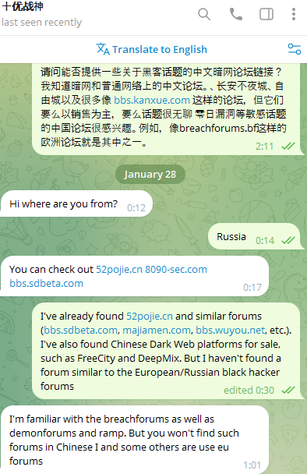
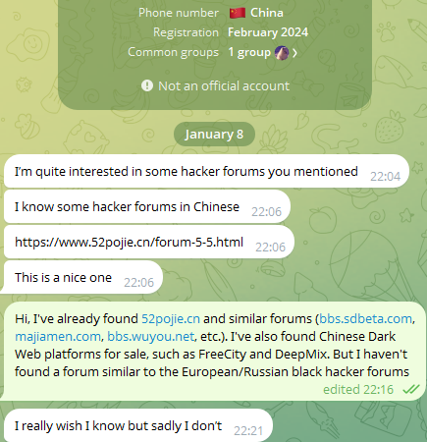
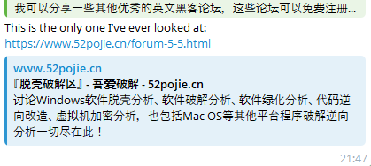
ёPRSTCON · The Dark Side of the Chinese Internet
26.05.2026 · MOW
— SLIDE 24 —
There are no familiar black forums in China
▶

Slide 25


ёPRSTCON · The Dark Side of the Chinese Internet
26.05.2026 · MOW
— SLIDE 25 —
Where are the remaining topics discussed?
Telegram
European/CIS forums
▶

Slide 26
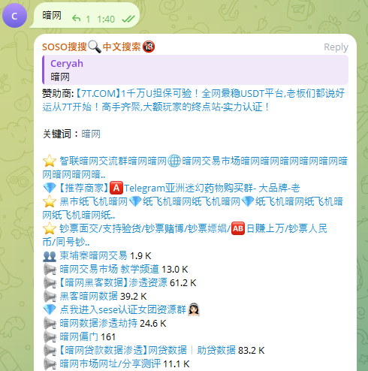
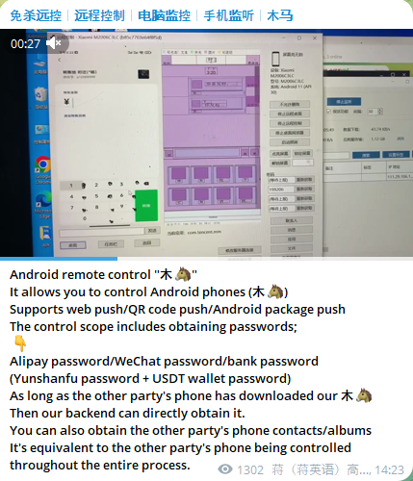
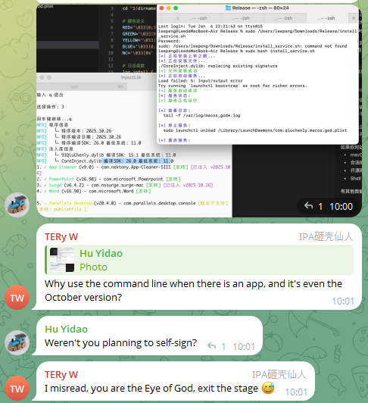
ёPRSTCON · The dark side of the Chinese Internet
26.05.2026 · MOW
— SLIDE 26 —
You can find anything on Telegram
Search engines
Sales of malware
Malware Development
▶

Slide 27




ёPRSTCON · The Dark Side of the Chinese Internet
26.05.2026 · MOW
— SLIDE 27 —
Conclusion
Chinese dark web
European/CIS dark web
Tor markets
Clearnet forums
Business forums
Telegram
Messengers
European/CIS business forums
Ransomware groups blogs
▶

Slide 28


ёPRSTCON · The Dark Side of the Chinese Internet
26.05.2026 · MOW
— SLIDE 28 —
Thank you!
▶

Slide 29
ёPRSTCON · The Dark Side of the Chinese Internet
26.05.2026 · MOW
— SLIDE 29 —
?
QUESTIONS · COMMENTS · DISAGREEMENTS
@yoprstcon · qqlan@ya.ru · yoprstcon.ru
▶

