Slide 1

OWASP SAMM · DEPARTURES
MAY 2026 · v0.3-DRAFT
— SLIDE 01 / TITLE —
AGENTIC SAMM
when developer is no longer the only actor
SERGEY GORDEYCHIK · scadastrangelove@gmail.com

Slide 2
OWASP SAMM · DEPARTURES
MAY 2026 · v0.3-DRAFT
— SLIDE 02 / SPEAKER —
CATCHING MY FLIGHT
05
SERGEY GORDEYCHIK
01 · WEB — wasc tc v2 / incident/vuln stat (2007)
02 · ICS / SCADA — scada strangelove (2012)
03 · SD-WAN new hop (2018)
04 · AI / ML SECURITY — talks, courses (2019)
05 · AGENTIC SYSTEMS — ASAMM (today)
https://www.linkedin.com/in/sergei-gordeichik-12413438b

Slide 3
OWASP SAMM · DEPARTURES
MAY 2026 · v0.3-DRAFT
— SLIDE 03 / FRAMING —
SAMM WORKS. THE BOUNDARY MOVED.
SAMM COVERS
ASAMM EXTENDS
· code and delivery artifacts
· software supply chain
· security testing & review
· vuln & incident management
· five SAMM functions, as designed
· context flows (RAG, memory)
· tool invocations as boundaries
· delegated authority & autonomy
· development as attack surface
· runtime behavior as assurance

Slide 4
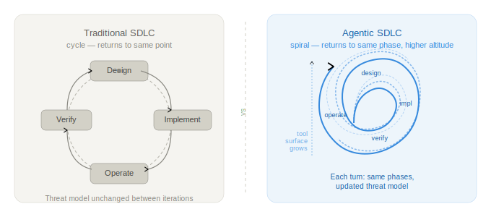
OWASP SAMM · DEPARTURES
MAY 2026 · v0.3-DRAFT
— SLIDE 04 / METAPHOR —
CYCLE BECAME A SPIRAL
returns to the same phase — but at a different altitude
tool surface grows · context changes · threat model updates with every turn

Slide 5
OWASP SAMM · DEPARTURES
MAY 2026 · v0.3-DRAFT
— SLIDE 05 / SCOPE —
FOUR SCENARIOS
04
01 · BUILDING — greenfield agentic system
02 · EMBEDDING — agent inside an existing product
03 · DEV WORKFLOW — claude code, cursor, copilot read your repo
04 · CONSUMING — mcp servers, agent-backed apis you trust
you are already in at least one

Slide 6
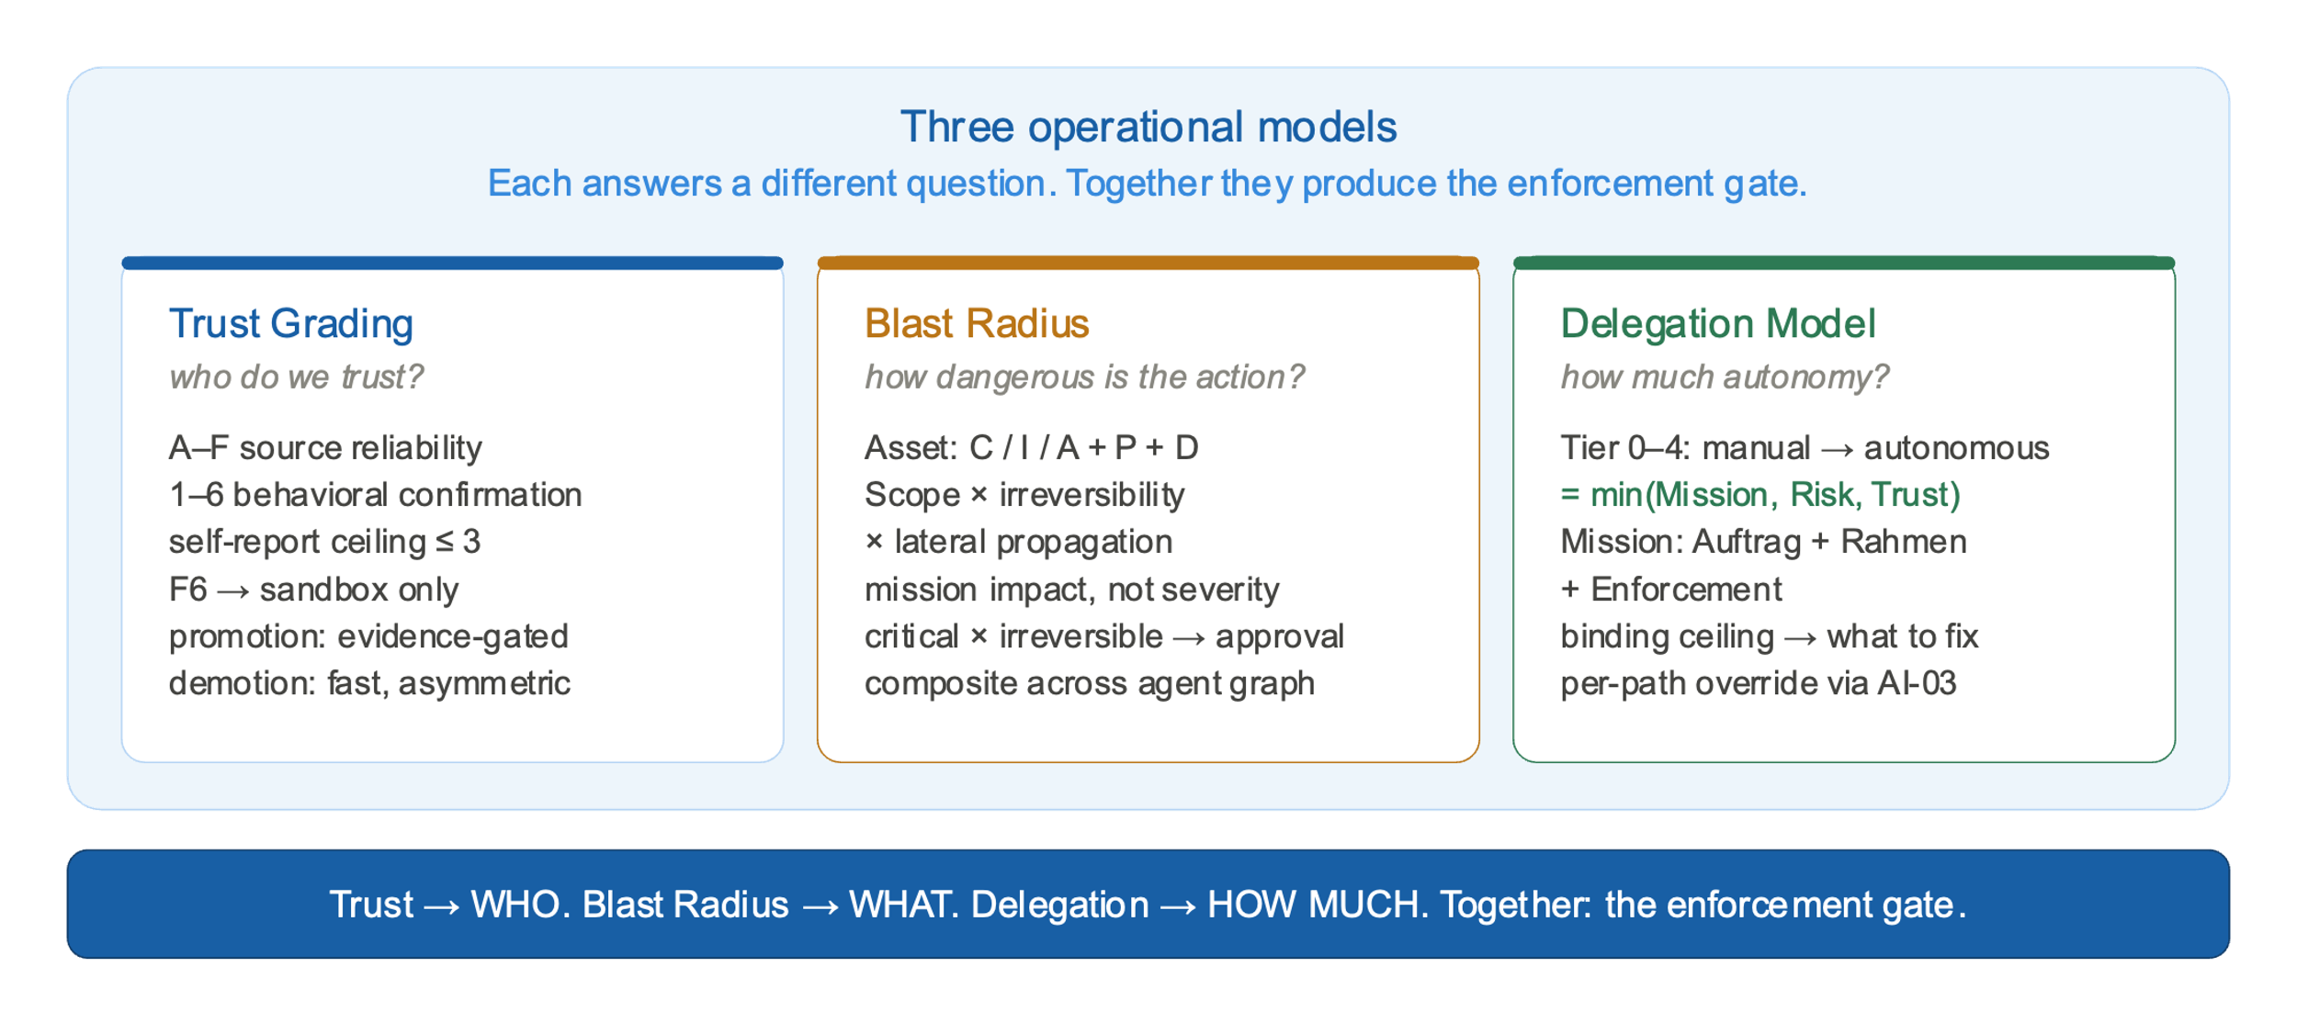
OWASP SAMM · DEPARTURES
MAY 2026 · v0.3-DRAFT
— SLIDE 06 / CONCEPT —
How to control unknown unknows. Untrusted unknows?

Slide 7
OWASP SAMM · DEPARTURES
MAY 2026 · v0.3-DRAFT
— SLIDE 07 / PROBLEM —
UNKNOWN. UNTRUSTED.
UNKNOWN UNKNOWNS
UNTRUSTED UNKNOWNS
· tool composition you didn’t predict
· context pollution from user input
· prompt drift over long sessions
· emergent strategies in long autonomy
· memory edits that change next-turn behavior
· content from search / retrieval
· outputs from upstream agents
· responses from mcp servers
· tool api contracts that changed
· third-party model behavior

Slide 8
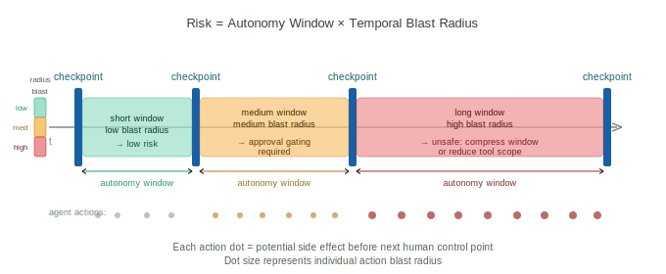
OWASP SAMM · DEPARTURES
MAY 2026 · v0.3-DRAFT
— SLIDE 08 / ONE CONTROL —
AD-02 · AUTONOMY WINDOW
Risk = Autonomy Window × Temporal Blast Radius
L1 windows measured · L2 threshold-gated checkpoints · L3 protocol-enforced bounds

Slide 9
OWASP SAMM · DEPARTURES
MAY 2026 · v0.3-DRAFT
— SLIDE 09 / RECEIPTS —
TWO RECEIPTS
DYNAMIC/FORENSIC
509 AUDITS, BROAD
· production security tooling pipeline
· 9 of 15 applicable controls at L0
· Setup: agent used as upstream node in a pipeline ending at a security scanner for client engagements.
· Cross-domain blast radius — agent output flows into offensive tooling against client networks.
· memory edits without audit trail
· 509 repositories scanned
· 20,241 files · 4,882 medium+ findings
· 88 native asamm findings
· autonomous loops · prompt override · trust-boundary expansion
https://github.com/scadastrangelove/agent-audit/

Slide 10
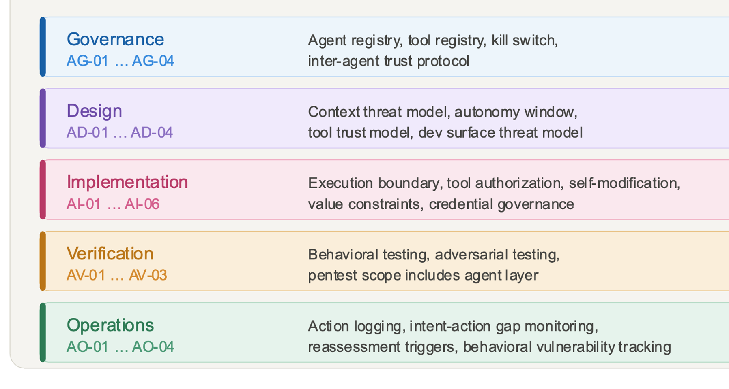
OWASP SAMM · DEPARTURES
MAY 2026 · v0.3-DRAFT
— SLIDE 10 / FRAMEWORK —
ASAMM AT A GLANCE
STRUCTURE
· 21 controls in current public draft
· AG-04 + AI-06 added in v0.3
· 5 SAMM function families: AG / AD / AI / AV / AO
· 6 axioms — incl. evidence primacy
· cc by-sa, open for review
· two adoption paths: migration · greenfield
· three audit tracks: a (self) · b (independent) · c (agent-as-auditor)
· evidence-based maturity L1 / L2 / L3
· maps to nist ai rmf · ncsc · owasp asi · aitg
· companion tooling: agent-audit (573 imported rules + native detectors)

Slide 11
OWASP SAMM · DEPARTURES
MAY 2026 · v0.3-DRAFT
— SLIDE 11 / TOOL —
AGENT-AUDIT AT A GLANCE
WHAT IT IS
WHAT IT GIVES YOU
· companion audit tool for ASAMM
· reads agent homes, session traces, and instruction-bearing repos
· separates raw hits, clustered issues, and reviewer artifacts
· built for maintainers, auditors, and corpus measurement
· turns abstract controls into inspectable evidence
· two primary entry modes: forensic and repository surface
· bridge mode joins static and dynamic evidence
· native detectors + imported packs + optional verifier
· JSON and Markdown bundles for operators and researchers
· calibration harnesses for rule evolution over time

Slide 12
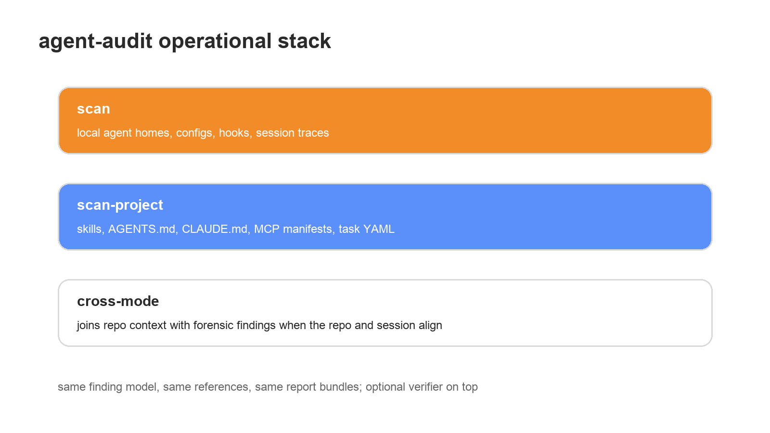
OWASP SAMM · DEPARTURES
MAY 2026 · v0.3-DRAFT
— SLIDE 12 / MODES —
TWO ENTRY MODES
01 · FORENSIC / SCAN — local agent home, configs, hooks, session logs
02 · REPOSITORY / SCAN-PROJECT — skills, AGENTS.md, CLAUDE.md, MCP manifests
03 · CROSS-MODE — static context reinforces dynamic findings
04 · VERIFY — optional context-aware triage for ambiguous results

Slide 13
OWASP SAMM · DEPARTURES
MAY 2026 · v0.3-DRAFT
— SLIDE 13 / FORENSIC —
FORENSIC / SCAN
INPUTS
OUTPUTS
· session JSONL from Claude Code, Codex, and OpenClaw-style traces
· agent configs, hooks, MCP settings, and local probes
· tool calls, autonomy windows, and evidence of risky chains
· optional repo resolution for follow-on cross-mode context
· verifier-ready records for triage when needed
· raw findings and sessions of concern
· verified-first Markdown and JSON bundles
· config patch suggestions where relevant
· machine-readable audit log for follow-up

Slide 14
OWASP SAMM · DEPARTURES
MAY 2026 · v0.3-DRAFT
— SLIDE 14 / STATIC —
REPOSITORY / SCAN-PROJECT
SURFACES
ARTIFACTS
· SKILL.md, AGENTS.md, and CLAUDE.md instruction files
· plugin manifests, task YAML, and prompt-bearing fields
· MCP manifests, tool descriptions, and capability declarations
· collections of repos for measurement and benchmarking
· AST-routed parsing before lexical rule application
· project-findings.md and project-findings.json
· clustered findings and files of concern
· security profile plus report profiles
· collection-scale rollups for repeated templates

Slide 15
OWASP SAMM · DEPARTURES
MAY 2026 · v0.3-DRAFT
— SLIDE 15 / PRECISION —
AST / SURFACE ROUTING
FLAT TEXT MODE
AGENT-AUDIT ROUTES
· code snippets trigger prose-oriented rules
· examples look like live capability declarations
· every regex sees every file as flat text
· manifests become opaque blobs instead of typed records
· false positives pile up before triage even begins
· markdown AST splits prose from code and examples
· prompt-bearing YAML fields are extracted explicitly
· MCP manifests are parsed at field granularity
· rules apply only on declared audit surfaces
· the same engine supports both product and corpus modes

Slide 16
OWASP SAMM · DEPARTURES
MAY 2026 · v0.3-DRAFT
— SLIDE 16 / SOURCES —
MANY SOURCES. ONE FINDING MODEL.
IMPORTED PACKS
NORMALIZED OUTPUT
· ATR
· Aguara
· Cisco PromptGuard
· Gitleaks
· NOVA and optional Cisco MCP YARA
· one severity model
· one finding and evidence model
· one audit-surface model
· dedup, canonical classes, collection grouping
· imported rules become comparable instead of siloed

Slide 17
OWASP SAMM · DEPARTURES
MAY 2026 · v0.3-DRAFT
— SLIDE 17 / NATIVE —
WHY NATIVE DETECTORS
PACKS ALONE MISS
WHY THEY EXIST
· approval gaps and broad external action without consent
· persistent identity rewrite and future-session carryover
· destructive or exfiltration chains across turns
· cross-server toxic flow between MCP tools
· absence-based controls with no obvious keyword trigger
· some findings are absence-based, not lexical
· some are behavioral, temporal, or cross-turn
· some require session structure, not flat text
· they map directly back into ASAMM controls
· this is where framework semantics become detector logic

Slide 18
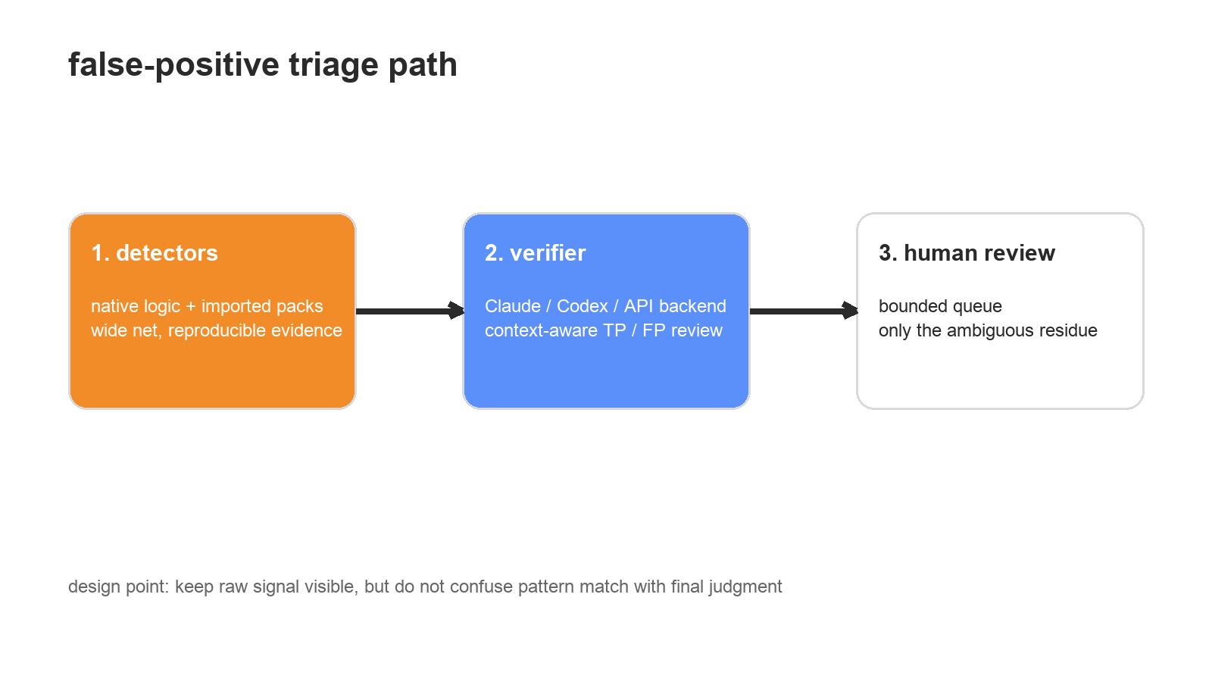
OWASP SAMM · DEPARTURES
MAY 2026 · v0.3-DRAFT
— SLIDE 18 / TRIAGE —
FP TRIAGE IS BUILT IN
Claude / Codex / API backends · default off · bounded by budget

Slide 19
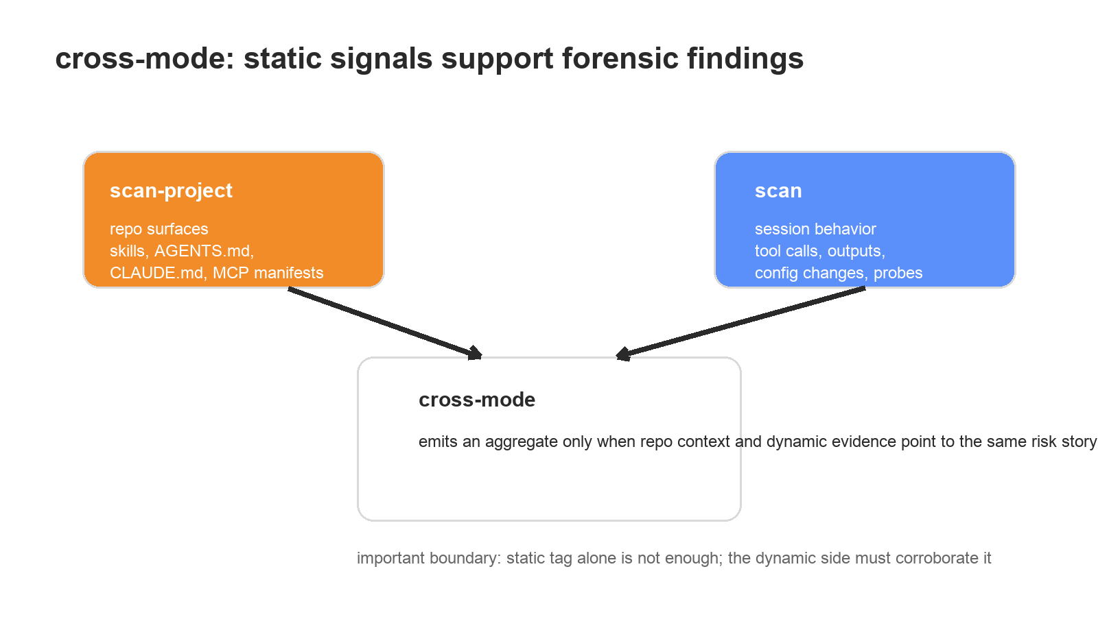
OWASP SAMM · DEPARTURES
MAY 2026 · v0.3-DRAFT
— SLIDE 19 / BRIDGE —
CROSS-MODE JOINS THE STORY

Slide 20
OWASP SAMM · DEPARTURES
MAY 2026 · v0.3-DRAFT
— SLIDE 20 / VALUE —
WHAT THIS ENABLES FOR ASAMM
PRACTICE
MEASUREMENT
· local agent audits after suspicious runs
· release gates for skills and MCP manifests
· third-party repo triage before trust decisions
· evidence that maps directly into controls
· repeatable review bundles for security teams
· 509-repo corpus scans and reviewer packs
· adjudication subsets for signal calibration
· regression harnesses for future rule packs
· a path from abstract controls to operational evidence

Slide 21
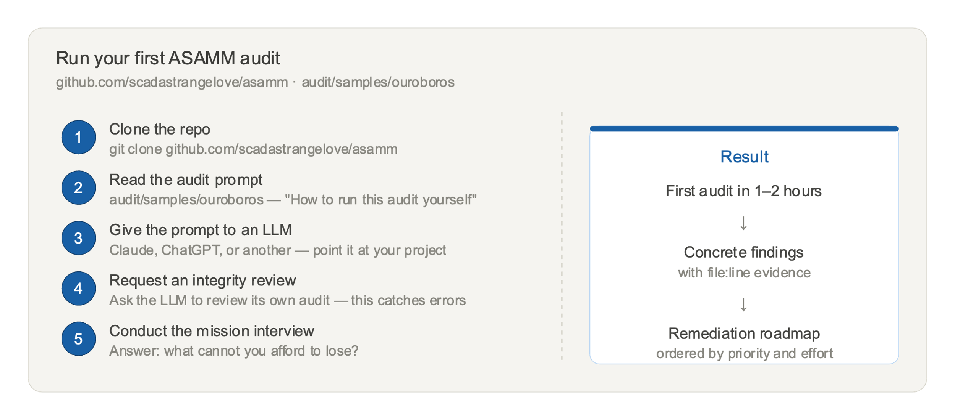
OWASP SAMM · DEPARTURES
MAY 2026 · v0.3-DRAFT
— SLIDE 11 / ASK —
?
crosswalk review · evidence-rule calibration · real audits
github.com/scadastrangelove/asamm · scadastrangelove@gmail.com

